Slide 1
DL Assignment 2 (Part 2)
By: Low Jun Jie, Ryan

Slide 2
Scope
Create a classification model to generate text characters based on a user input
Data used will be the first Harry Potter Book
Models will utilize Recurrent Neural Networks (RNNs)

Slide 3
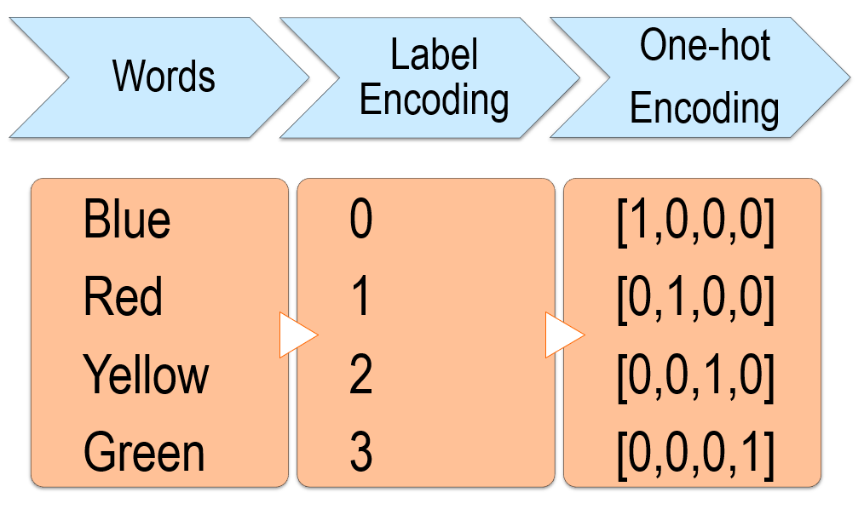
Data Processing
Raw data is loaded and cleansed (headers, footers, etc.)
Sequences and characters are extracted from the data
One-hot encoding used to label characters to binary arrays
Example of one-hot encoding.

Slide 4



Initial Models (Models 1-3)
SimpleRNN, LSTM, and GRU layers tested.
Optimizer: RMSprop (0.01 Learning Rate)
Training: Batch Size 128, Validation Split 0.2, Epochs 20
SimpleRNN Model.
LSTM Model.
GRU Model.

Slide 5
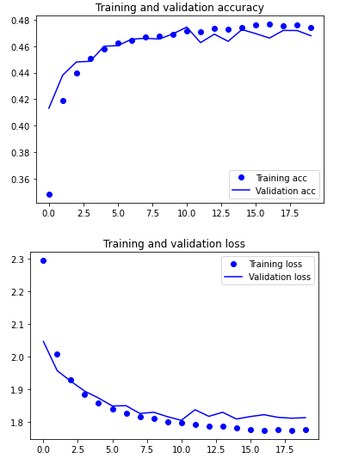
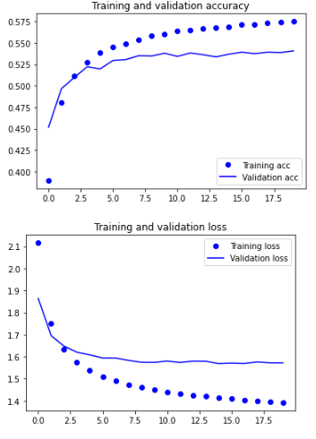
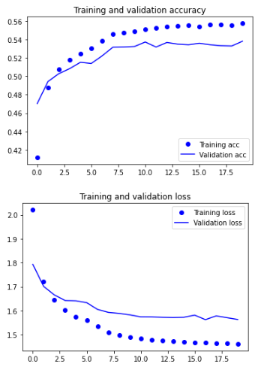




Initial Models (Models 1-3)
LSTM performed the best among the 3 layers.
Can obtain better validation accuracy than GRU.
LSTM is hence chosen as the main RNN layer.
SimpleRNN Performance
LSTM Performance
GRU Performance

Slide 6
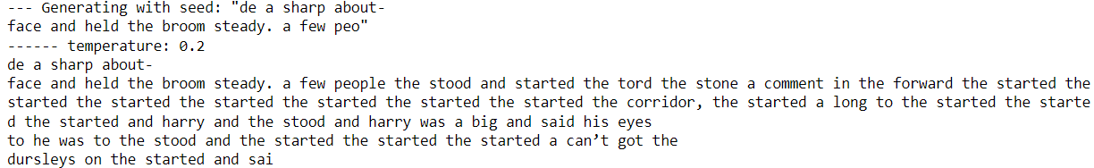
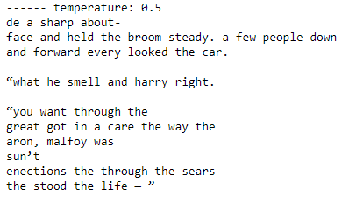

Initial LSTM Model (Model 2)
Words are somewhat coherent with each other
Sentences only have some form of grammar
LSTM Model Text Generated.

Slide 7

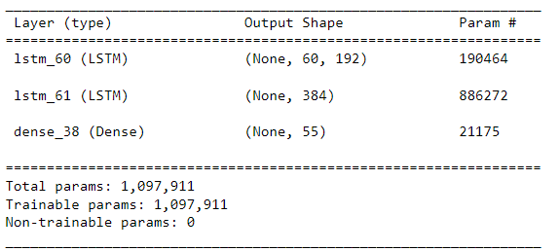
Scaled Up Model (Model 10)
Model was scaled up to obtain higher accuracy.
Two RNN layers was found to perform the best (over one and three layers).
RNN layers have 192 and 384 nodes respectively.
Model 10 Parameters.

Slide 8
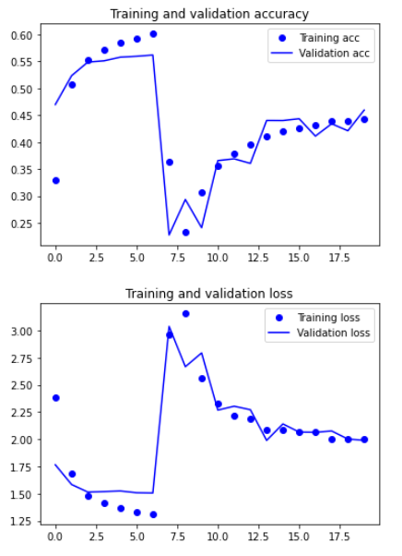


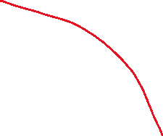
Scaled Up Model (Model 10)
Slightly above 0.55 peak validation accuracy
Overfits/vanishes at around 6 epochs
Model 10’s Highest Accuracy.
Model 10 Performance.

Slide 9
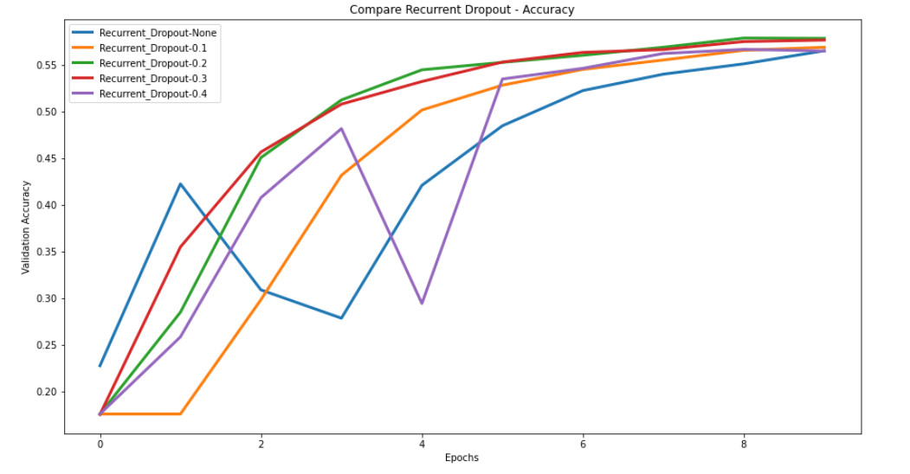
Fine-Tuned Model (Model 12)
Hyperparameters (optimizers, dropout, batch size, etc.) were fine-tuned through multiple tests
Models were compared against each other
The highest accuracy model was selected for each test
Comparing models with different recurrent dropouts.

Slide 10


Fine-Tuned Model (Model 12)
Before:
Recurrent Dropout: None
Dropout: None
Optimizer: RMSprop (0.01)
Batch Size: 128
Validation Split: 0.2
Epochs: 20
After:
Recurrent Dropout: 0.2
Dropout: 0.2
Optimizer: RMSprop (0.01)
Batch Size: 1024
Validation Split: 0.3
Epochs: 10
Model 10’s Highest Accuracy.
Model 12’s Highest Accuracy.

Slide 11
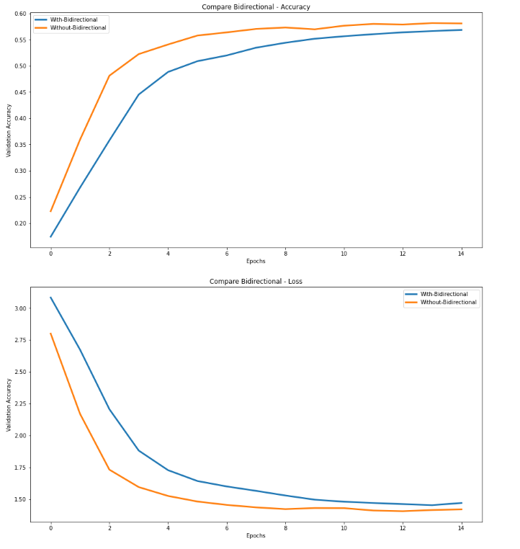

Final Model (Model 15) + Results
Same configuration as Model 12
Compared against Bidirectional Layers
Trained for 15 epochs (previously 10)
Model 15’s Highest Accuracy.
Model 15’s Performance against Bidirectional Model.

Slide 12
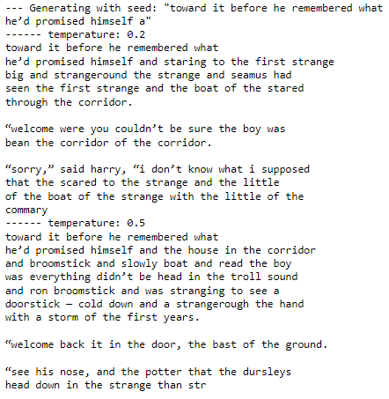
Final Model (Model 15) + Results
Words make more sense with each other
Grammar is slightly better than before
Improvement from initial LSTM model

Slide 13
Modified Models

Slide 14
Summary
Model only showed slight improvement after many changes
More techniques can be experimented with (e.g., Batch Normalization)
More data can be used for higher accuracy/better texts generated

